Slide 1



PHENOLIC COMPOUNDS: PRODUCTION, REACTION SCHEME, AND APPLICATIONS
Presented by Group 24

Slide 2
OUR TEAM
Shivam Kalambe 210107079
Shivaraj R Kolli 210107080
Siddhant Srivastava 210107081

Slide 3
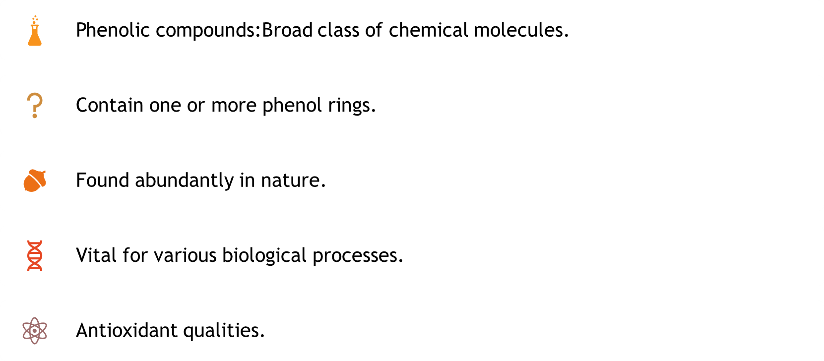
INTRODUCTION TO PHENOLIC COMPOUNDS:

Slide 4

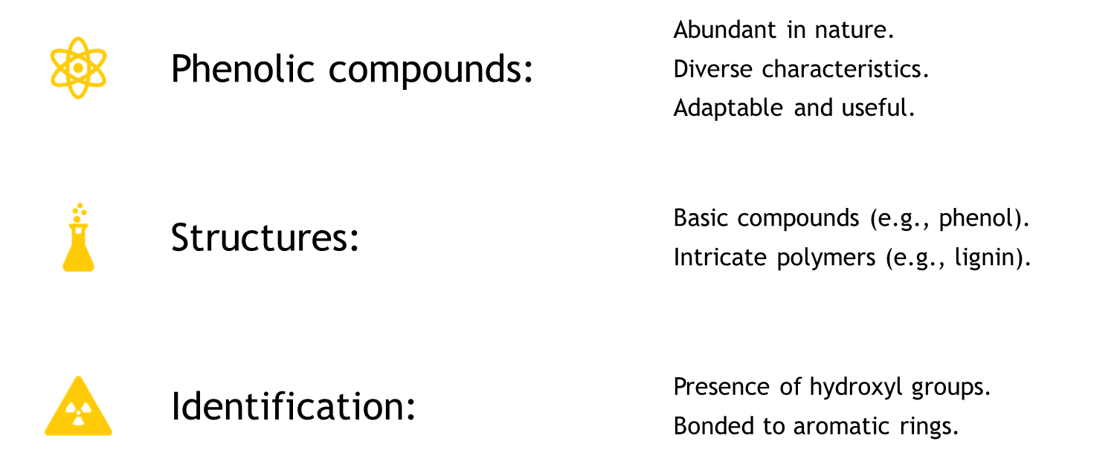
PHENOLIC COMPOUNDS: NATURE'S VERSATILE MOLECULES

Slide 5
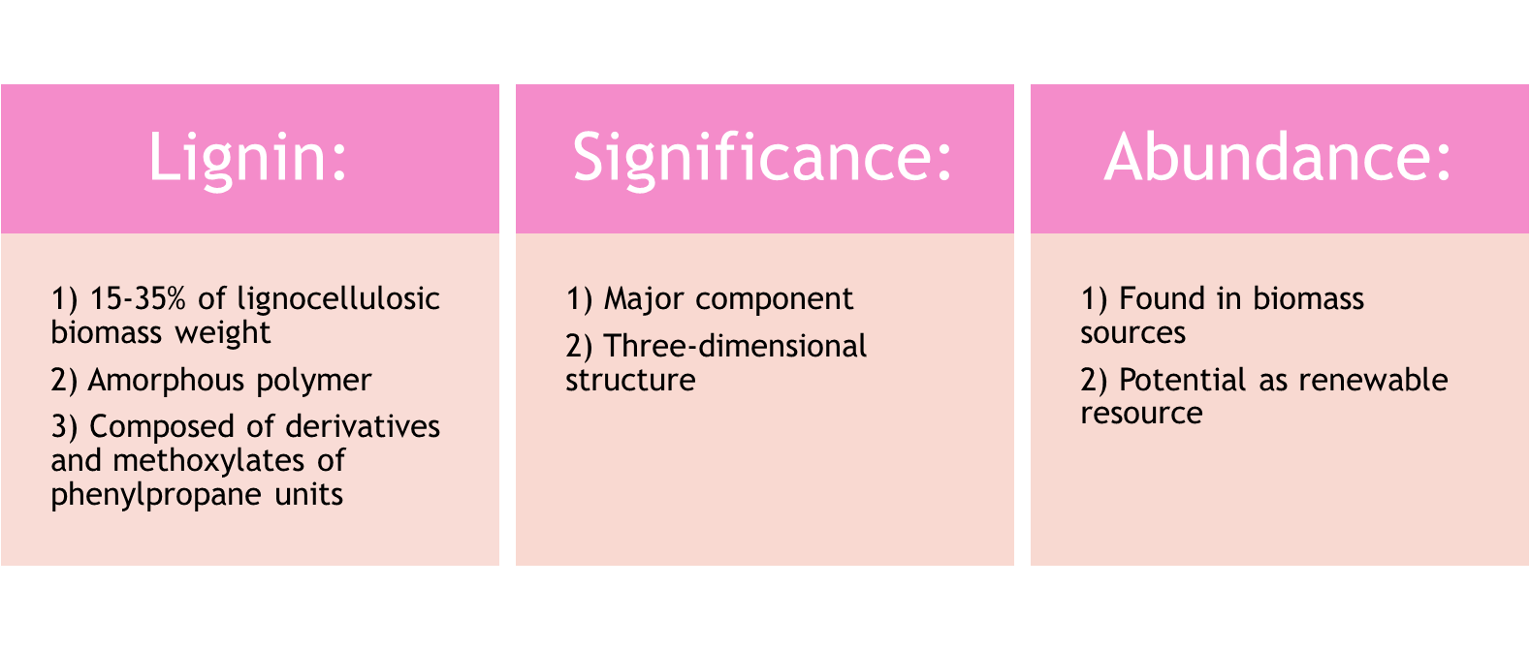
LIGNIN: A SIGNIFICANT COMPONENT OF BIOMASS:

Slide 6



PRODUCTION OF LIGNIN:
•Lignin:
•Key component of lignocellulosic biomass
•Extracted from plant materials like wood
•Various industrial extraction techniques used
•Extraction process:
•Separates lignin from cellulose and hemicellulose
•Kraft process:
•Commonly used in pulp and paper industry
•Phases involved:
•Cooking
•Washing
•Screening
•Bleaching

Slide 7
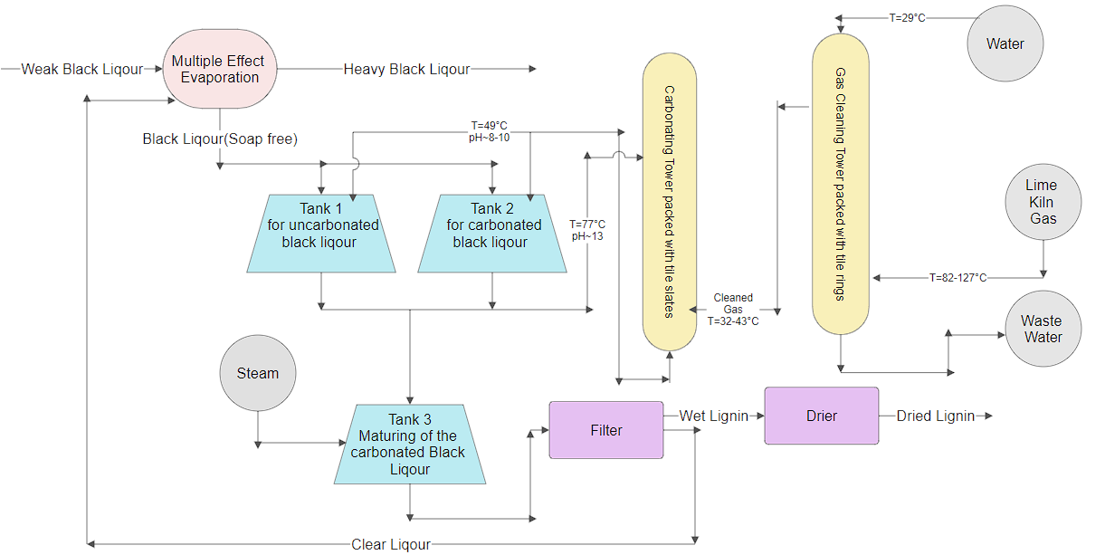

Slide 8
LIGNIN, PRODUCED FROM THIS PROCESS, CAN BE CHEMICALLY MODIFIED FOR VARIOUS INDUSTRIAL USES. ITS PHENYLPROPANE UNITS ALLOW FOR ALTERATION THROUGH REACTIONS, LIKE ADDING FUNCTIONAL GROUPS WITH EPICHLOROHYDRIN
Lignin + Epichlorohydrin Modified lignin with functional groups
•Modified lignin used for:
•Carbon fibers
•Phenolic chemicals
•Multifunctional hydrocarbons
•Extraction and modification of lignin:
•Demonstrates potential as renewable resource
•Assists in creating sustainable materials and goods

Slide 9
LIGNIN ISOLATION PROCESS:
•Isolation methods for lignin:
•Over 90% of industrial lignin produced via sulphate and sulphite procedures
•Byproducts of wood processing:
1) Kraft lignin:
•Isolated under highly alkaline conditions
•Sulphate process breaks lignin into smaller chains
•Makes lignin soluble in water and alkaline solutions
•Contains sulphur compounds like sodium sulphide with hydrophobic thiol groups

Slide 10
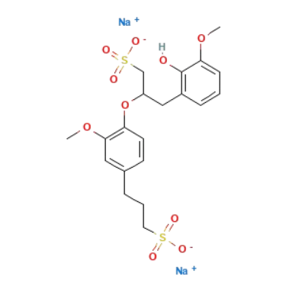
2) LIGNOSULFONATES:
PRODUCED BY SULFITE PULPING METHOD
USES ACIDIC SOLUTION INSTEAD OF ALKALINE MEDIUM
SULFONATE-LIKE (SO ) BUT SULPHIDE-LIKE IN NATURE
-
3

Slide 11
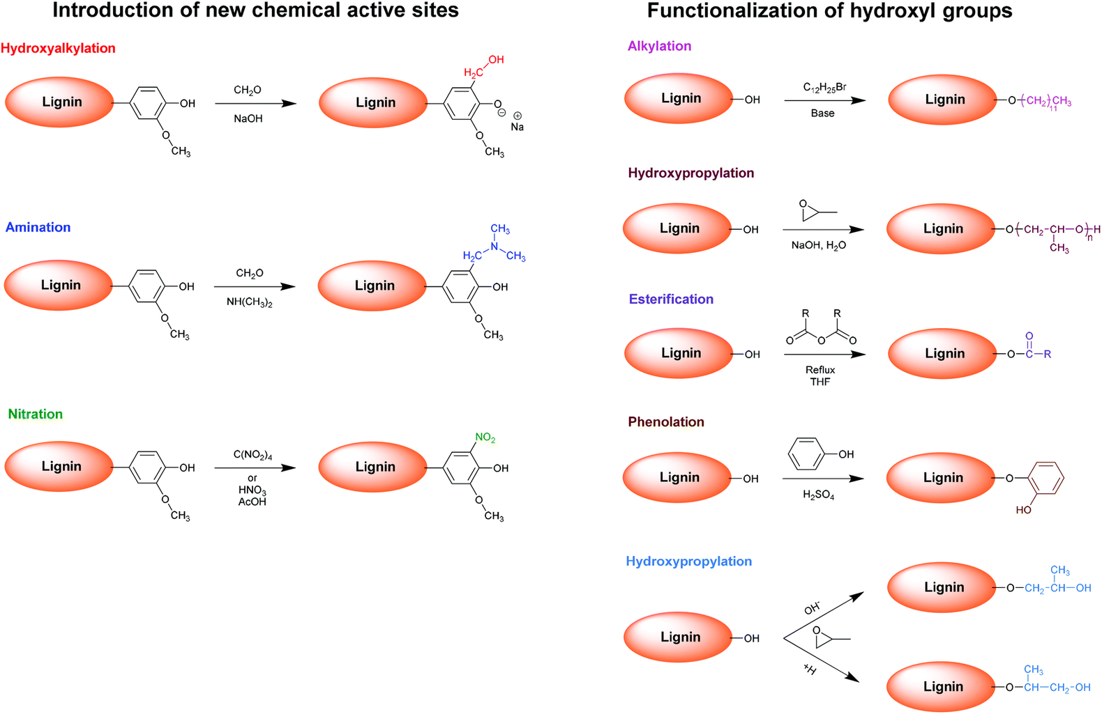
LIGNIN MODIFICATION REACTIONS:
FIGURE 1

Slide 12
APPLICATIONS OF LIGNIN:
1
Adsorption of Heavy Metal Ions in Water:
Lignin's complex structure and functional groups (phenolic, carboxylic) make it effective in binding and extracting heavy metal ions from water.
Nanoparticle Synthesis:
Polyphenolic structure and reducing agent properties of lignin make it a useful precursor for creating nanoparticles.
Lignin nanoparticles have shown potential in medicine delivery, imaging, and catalysis due to their special qualities and biocompatibility.
2

Slide 13
3
Supercapacitor Electrodes:
Carbon compounds from lignin have high surface area, porosity, and electrical conductivity.
Used in supercapacitor electrodes for efficient energy storage and release.
LLDPE/Lignin Films:
Used in coatings, agricultural films, and packaging, reducing reliance on fossil fuel-derived polymers.
Biochemicals Derived from Kraft Lignin:
Used in adhesives, resins, flavors, scents, and other applications.
4
5

Slide 14
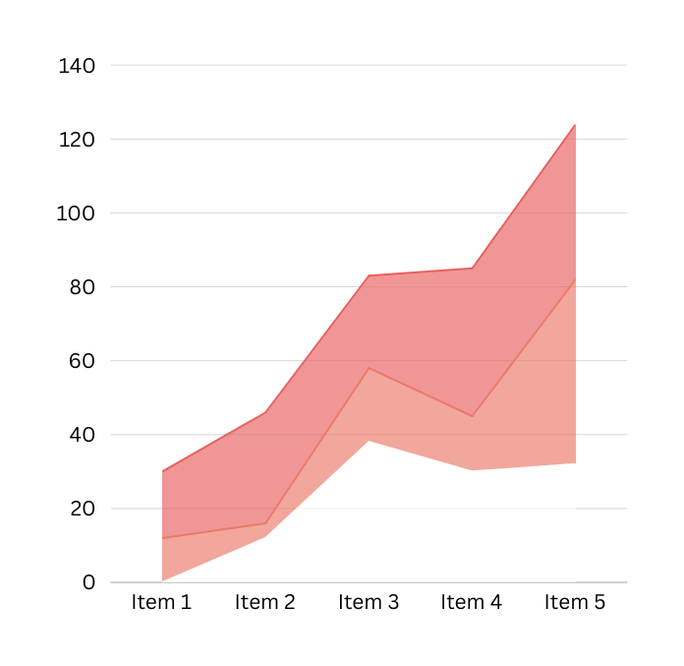
REFERENCES
Text:
1)Dryden’s Outlines Of Chemical Technology
2) https://www.jchemrev.com/article_160707.htmle.
Figure 1:
https://pubs.rsc.org/image/article/2016/GC/c5gc02616d/c5gc02616d-f3_hi-res.gif.

Slide 15
THANK
YOU

